Slide 1


LECTURE 4: IMPEDANCE CONTROL
RO47013 CONTROL IN HUMAN-ROBOT INTERACTION
Luka Peternel
Cognitive Robotics, 3mE, Delft University of Technology, The Netherlands
All slides and images were created by Luka Peternel (unless indicated otherwise).
Revision date: 25.2.2023

Slide 2
LEARNING GOALS
After this lecture, the student should be able to:
Understand the theory of impedance control for human-robot interaction.
Apply the theory to perform basic tasks with an impedance-controlled robot:
position/velocity reference following
make a compliant/stiff interaction with an external environment and humans
Critically reflect on:
the benefits of variable impedance in different conditions
the effect of configuration and manipulability on the robot control and its relation to stiffness

Slide 3
MOTIVATION

Slide 4


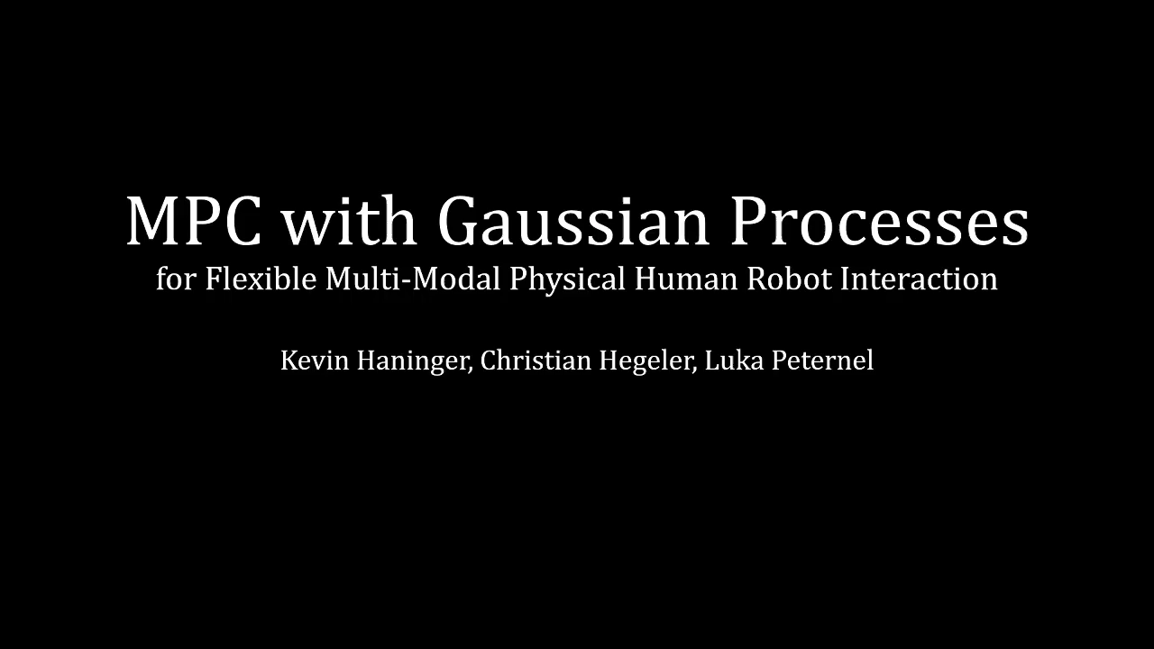
IMPEDANCE CONTROL FOR SAFE AND EFFICIENT INTERACTION
Peternel L, Tsagarakis N, Ajoudani A (2017), A human–robot co-manipulation approach based on human sensorimotor information. IEEE Transactions on Neural Systems and Rehabilitation Engineering, 25(7):811-22.
Peternel, L., Petrič, T., & Babič, J. (2018). Robotic assembly solution by human-in-the-loop teaching method based on real-time stiffness modulation. Autonomous Robots, 42(1), 1-17.
Haninger, K., Hegeler, C., & Peternel, L. (2022). Model Predictive Control with Gaussian Processes for Flexible Multi-Modal Physical Human Robot Interaction. 2022 IEEE International Conference on Robotics and Automation (ICRA 2022) (pp. 6948-6955).

Slide 5
IMPEDANCE CONTROL FOR SAFE AND EFFICIENT INTERACTION
Humans simplify and improve the control of interaction with unknown and unpredictable environments by regulating their arm’s impedance [Hogan 1984, Burdet 2001].
By changing arm stiffness (one of the parameters of impedance) we can make the arm either soft or stiff, depending on the type of physical interaction we desire.
This principle can be exploited for the control of physical interaction on robots [Hogan 1985] and is important for human-robot interaction [Peternel 2017].
Hogan, N. (1984). Adaptive control of mechanical impedance by coactivation of antagonist muscles. IEEE Transactions on automatic control, 29(8), 681-690.
Hogan, N. (1985). Impedance control: An approach to manipulation, Journal of Dynamic Systems, Measurement, and Control, 107.
Burdet, E., Osu, R., Franklin, D. W., Milner, T. E., & Kawato, M. (2001). The central nervous system stabilizes unstable dynamics by learning optimal impedance. Nature, 414(6862), 446-449.
Peternel L, Tsagarakis N, Ajoudani A (2017), A human–robot co-manipulation approach based on human sensorimotor information. IEEE Transactions on Neural Systems and Rehabilitation Engineering, 25(7):811-22.

Slide 6

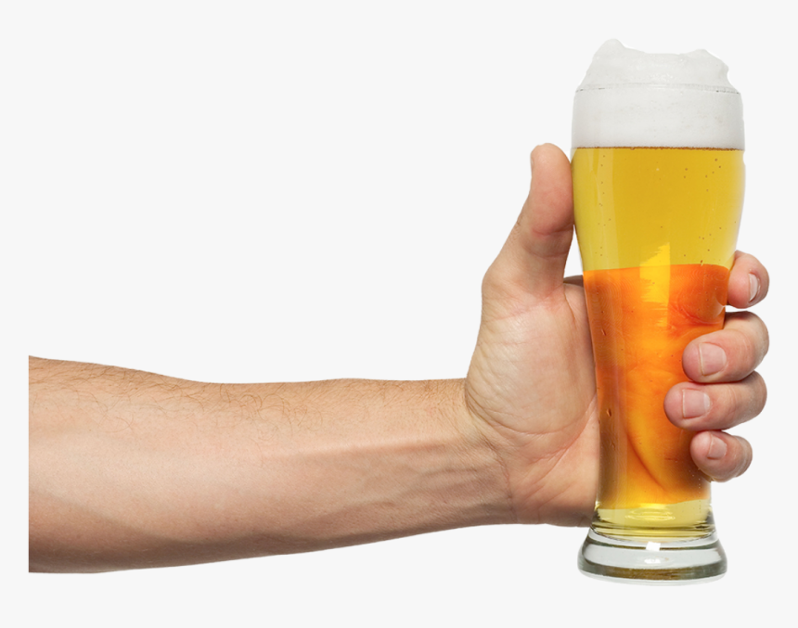
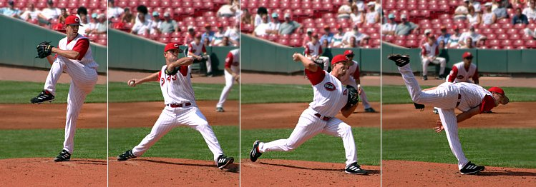
IMPEDANCE CONTROL FOR SAFE AND EFFICIENT INTERACTION
Three main cases where impedance (stiffness) control can be beneficial:
Safety: if the environment is unknown, the robot might break something fragile or damage itself, if the interaction is done with a high stiffness. To ensure a safe interaction, stiffness should be decreased.
Precision & robustness: if the environment is unpredictable or unstable, it may induce unexpected perturbations to the robot. To ensure robustness and adequate position tracking, stiffness should be increased.
Energy efficiency: improved energy transfer in various tasks can be improved by a correctly timed change of stiffness.
?

Slide 7
IMPEDANCE CONTROL FOR SAFE AND EFFICIENT INTERACTION
Three main cases where impedance (stiffness) control can be beneficial:
Safety: if the environment is unknown, the robot might break something fragile or damage itself, if the interaction is done with a high stiffness. To ensure a safe interaction, stiffness should be decreased.
Precision & robustness: if the environment is unpredictable or unstable, it may induce unexpected perturbations to the robot. To ensure robustness and adequate position tracking, stiffness should be increased.
Energy efficiency: improved energy transfer in various tasks can be improved by a correctly timed change of stiffness.
?
EXAMPLES
Safety: You are in a dark room, and you keep your arm softer when trying to approach and touch an unseen or unknown object.
Precision: You hold a glass of beer in a crowded party, and you stiffen your arm not to spill it in case someone might bump into you by accident.
Energy: You use elasticity in arm actuators (e.g., muscles) to store and release energy during explosive actions, such as throwing, jumping, etc.

Slide 8
IMPEDANCE CONTROL FOR SAFE AND EFFICIENT INTERACTION
Three main cases where impedance (stiffness) control can be beneficial:
Safety: if the environment is unknown, the robot might break something fragile or damage itself, if the interaction is done with a high stiffness. To ensure a safe interaction, stiffness should be decreased.
Precision & robustness: if the environment is unpredictable or unstable, it may induce unexpected perturbations to the robot. To ensure robustness and adequate position tracking, stiffness should be increased.
Energy efficiency: improved energy transfer in various tasks can be improved by a correctly timed change of stiffness.
?
Note: in order to store and release energy, the arm or its actuators require mechanical elasticity (e.g., like human muscles). Standard electric motors in robots by themselves do not have such elastic properties.

Slide 9
MECHANICAL IMPEDANCE

Slide 10
MECHANICAL IMPEDANCE/ADMITTANCE: THE BASICS
Impedance provides a relationship between the force (effort) and the motion (flow):
Admittance is the inverse of impedance:
Impedance includes various parameters (stiffness, damping, inertia, etc.), each corresponding to either position or one of its time derivatives (velocity, acceleration, etc.).
In theory, there may be an infinite number of them, if we keep increasing the order of derivatives. However, in practice we usually do not go beyond acceleration since the measurement of variables becomes impractical.
Therefore, impedance can be represented by a mass-damper-spring model.

Slide 11
MECHANICAL IMPEDANCE/ADMITTANCE: THE BASICS
Impedance provides a relationship between the force (effort) and the motion (flow):
Admittance is the inverse of impedance:
Impedance includes various parameters (stiffness, damping, inertia, etc.), each corresponding to either position or one of its time derivatives (velocity, acceleration, etc.).
In theory, there may be an infinite number of them, if we keep increasing the order of derivatives. However, in practice we usually do not go beyond acceleration since the measurement of variables becomes impractical.
Therefore, impedance can be represented by a mass-damper-spring model.
Note: the concept of mechanical impedance is one of the most fundamental and essential ways of understanding classical mechanics.
It unifies some of the physics' fundamental laws and concepts, such as Newton’s second law of motion, Hooke’s law, damping, etc.

Slide 12
MASS-DAMPER-SPRING MODEL
damping
stiffness

Slide 13
MASS-DAMPER-SPRING MODEL
inertia

Slide 14
MASS-DAMPER-SPRING MODEL
inertia

Slide 15
MASS-DAMPER-SPRING MODEL
inertia
damping

Slide 16
MASS-DAMPER-SPRING MODEL
inertia
damping

Slide 17
MASS-DAMPER-SPRING MODEL
inertia
damping
stiffness

Slide 18
MASS-DAMPER-SPRING MODEL
inertia
damping
stiffness

Slide 19
MASS-DAMPER-SPRING MODEL
JOINT SPACE EQUIVALENT
inertia
damping
stiffness

Slide 20
IMPEDANCE OF MACHANICAL SYSTEM AT SPECIFIC POINT
We have a complex machincal structure (e.g., robotic arm).
How would it behave if we interact with it at an arbitrary point (e.g., endpoint x)?
Such a structure has many connected mechicnal elements that contribute to the interaction.
Can we simplify the way we describe the interaction behaviour at a specific point?

Slide 21
IMPEDANCE OF MACHANICAL SYSTEM AT SPECIFIC POINT
We have a complex machincal structure (e.g., robotic arm).
How would it behave if we interact with it at an arbitrary point (e.g., endpoint x)?
Such a structure has many connected mechicnal elements that contribute to the interaction.
Can we simplify the way we describe the interaction behaviour at a specific point?

Slide 22
IMPEDANCE OF MACHANICAL SYSTEM AT SPECIFIC POINT
The interaction at the endpoint can be described by the impedance, composed of virtual mass, damper and spring:
Note: the above equation assumes that the force is acting from the robot on the environment (i.e., from the robot’s perspective).
If you reverse the signs of reference and actual positions x, it will be from the environment on the robot (i.e., as shown in the figure).

Slide 23
IMPEDANCE OF MACHANICAL SYSTEM AT SPECIFIC POINT
The interaction at the endpoint can be described by the impedance, composed of virtual mass, damper and spring:
inertia
matrix
damping
matrix
stiffness
matrix
Note: m represents the dimension of Cartesian space (typically three positions and three rotations). Variable x is typically a vector of positions and orientations.
In practice, inertia is not often included, due to difficulty of measuring acceleration and since not many practical tasks require control of acceleration.

Slide 24
ENDPOINT IMPEDANCE CONTROL

Slide 25
EXAMPLE: ENDPOINT POSITION TRACKING
If we have a model to compensate arm dynamics, we can use a virtual impedance at the endpoint to control its motion.
The impedance controller includes virtual spring-damper:
We use spring element to force the robot endpoint toward the reference position.
Note: in this scenario, we want to move the robot endpoint from its actual position to the desired reference position (green cross).

Slide 26
EXAMPLE: ENDPOINT POSITION TRACKING
Note: if the elastic element (i.e., spring) is not (properly) damped, it will oscillate and cause instability of the impedance controller. We can use D = 2ξ√K, with ξ = 0.7 for critically damped system [Albu-Schaffer 2013].
Note: a more complete formulation of damping control is:
Damping term is added to stabilise the spring.
Albu-Schaffer, A., Ott, C., Frese, U., & Hirzinger, G. (2003). Cartesian impedance control of redundant robots: Recent results with the DLR-light-weight-arms. In 2003 IEEE International Conference on Robotics and Automation (Vol. 3, pp. 3704-3709).

Slide 27
EXAMPLE: ENDPOINT POSITION TRACKING
Note: virtual spring of the controller produces a force that acts toward the reference position, which is the equilibrium of the spring.

Slide 28
EXAMPLE: ENDPOINT POSITION TRACKING

Slide 29
EXAMPLE: EXTERNAL DISTURBANCE OR COLLISION
Note: in this scenario, an external object hits the robot endpoint and causes a perturbation.

Slide 30
EXAMPLE: EXTERNAL DISTURBANCE OR COLLISION
Note: the robot will oppose the external object with a force that depends on the displacement from the reference position and is proportional to the value of stiffness.
If the perturbation is considered as annoyance, stiffness can be increased to improve the position tracking.
If the external object is a human, the robot should ideally operate with a low stiffness to ensure a safe interaction.

Slide 31
INFLUENCE OF ENVIRONMENT IMPEDANCE
If the environment, with which the robot interacts, is not infinitely stiff, the perceived stiffness is a combination of commanded robot stiffness and environment stiffness.
The calculation of combined stiffness follows a principle of springs connected in series:
In equilibrium state robot force is equal to the environment force:

Slide 32
INFLUENCE OF ENVIRONMENT IMPEDANCE
If the environment, with which the robot interacts, is not infinitely stiff, the perceived stiffness is a combination of commanded robot stiffness and environment stiffness.
The calculation of combined stiffness follows a principle of springs connected in series:
In equilibrium state robot force is equal to the environment force:
The total displacement of two springs in series is:
The force between the two springs is equal, thus:
Therefore, the above expression leads to the combined total stiffness:

Slide 33
INFLUENCE OF ENVIRONMENT IMPEDANCE
If the environment, with which the robot interacts, is infinitely stiff, the perceived stiffness is the commanded robot stiffness:

Slide 34
INFLUENCE OF ENVIRONMENT IMPEDANCE
If the commanded robot stiffness is infinitely stiff, the perceived stiffness through is the environment stiffness:

Slide 35
IMPEDANCE/ADMITTANCE: FROM CONTROL PERSPECTIVE
Impedance controller takes a (measured) position/motion as an input and controls the force as an output:
Admittance controller takes a (measured) force as an input and controls the position/motion as an output:

Slide 36
IMPEDANCE/ADMITTANCE: FROM CONTROL PERSPECTIVE
Impedance controller takes a (measured) position/motion as an input and controls the force as an output:
Admittance controller takes a (measured) force as an input and controls the position/motion as an output:
Admittance controller can be used to make a classic position-control robot (i.e., without joint torque control capacity) to be complaint. This can be achieved by mounting a force sensor at the endpoint of the robot where the interaction with the environment is taking place.

Slide 37
IMPEDANCE/ADMITTANCE: FROM CONTROL PERSPECTIVE
When controlling a robot (plant) with an impedance controller, the robot (plant) acts as an admittance.
When controlling a robot (plant) with an admittance controller, the robot (plant) acts as an impedance.

Slide 38
RELATIONSHIP BETWEEN MANIPULABILITY AND IMPEDANCE

Slide 39
ARM MANIPULABILITY MEASURES
Manipulability [Yoshikawa 1985] measures the ability of an articulated mechanical structure to produce the endpoint movements with the joint movements.
If m=n, scalar manipulability measure is given by:
Manipulability ellipsoids provide a representation of the ability to move or sustain/produce forces in different directions of Cartesian space. They can be obtained by SVD of Jacobian matrix:
Singular vectors and values determine orientation and shape of ellipsoid, respectively.
VELOCITY MANIPULABILITY
FORCE MANIPULABILITY
Yoshikawa, T. (1985). Manipulability of robotic mechanisms. The international journal of Robotics Research, 4(2), 3-9.

Slide 40
ARM MANIPULABILITY MEASURES
Manipulability [Yoshikawa 1985] measures the ability of an articulated mechanical structure to produce the endpoint movements with the joint movements.
If m=n, scalar manipulability measure is given by:
Manipulability ellipsoids provide a representation of the ability to move or sustain/produce forces in different directions of Cartesian space. They can be obtained by SVD of Jacobian matrix:
Singular vectors and values determine orientation and shape of ellipsoid, respectively.
INTUITIVE EXPLANATION
Velocity manipulability: for the same joint movements you can produce different magnitudes of endpoint movement in different directions of Cartesian space (e.g., you produce more movement in the direction where the velocity manipulability ellipsoid is elongated).
Force manipulability: for the same joint torques you can produce different magnitudes of endpoint force in different directions in different directions of Cartesian space (e.g., you produce more force in the direction where the force manipulability ellipsoid is elongated).
VELOCITY MANIPULABILITY
FORCE MANIPULABILITY
Yoshikawa, T. (1985). Manipulability of robotic mechanisms. The international journal of Robotics Research, 4(2), 3-9.

Slide 41
ARM MANIPULABILITY MEASURES
Manipulability [Yoshikawa 1985] measures the ability of an articulated mechanical structure to produce the endpoint movements with the joint movements.
If m=n, scalar manipulability measure is given by:
Manipulability ellipsoids provide a representation of the ability to move or sustain/produce forces in different directions of Cartesian space. They can be obtained by SVD of Jacobian matrix:
Singular vectors and values determine orientation and shape of ellipsoid, respectively.
Note: in this 2D example, the first column of matrix U is the vector that indicates the direction of the major principal axis of manipulability ellipsoid, while the second column is the vector that indicates the direction of the minor principal axis. These are unit vectors, therefore, the lengths of ellipsoid’s major and minor principal axes are defined by the respective values of diagonal matrix ∑.
VELOCITY MANIPULABILITY
FORCE MANIPULABILITY
Yoshikawa, T. (1985). Manipulability of robotic mechanisms. The international journal of Robotics Research, 4(2), 3-9.

Slide 42
ARM MANIPULABILITY MEASURES
Manipulability [Yoshikawa 1985] measures the ability of an articulated mechanical structure to produce the endpoint movements with the joint movements.
If m=n, scalar manipulability measure is given by:
Manipulability ellipsoids provide a representation of the ability to move or sustain/produce forces in different directions of Cartesian space. They can be obtained by SVD of Jacobian matrix:
Singular vectors and values determine orientation and shape of ellipsoid, respectively.
Note: if Jacobian is not a square matrix, then JJ^{T} for m<n and J^{T}J for m>n can be used. Nowadays, many robots have redundant degrees of freedom, therefore JJ^{T} is used.
In that case, the magnitude of principal axes is obtained by a square root of singular values of JJ^{T} for velocity manipulability and (JJ^{T})⁻¹ for force manipulability, respectively.
VELOCITY MANIPULABILITY
FORCE MANIPULABILITY
Yoshikawa, T. (1985). Manipulability of robotic mechanisms. The international journal of Robotics Research, 4(2), 3-9.

Slide 43
RELATIONSHIP TO SINGULARITY
Relationship to singularity: when the arm is in a singular configuration (determinant of Jacobian matrix is zero), the arm endpoint will lose the ability to move in one or more directions of Cartesian space.
In a singular configuration, the arm can sustain a large force in the direction where the movement is impaired.

Slide 44
RELATIONSHIP TO SINGULARITY
Relationship to singularity: when the arm is in a singular configuration (determinant of Jacobian matrix is zero), the arm endpoint will lose the ability to move in one or more directions of Cartesian space.
In a singular configuration, the arm can sustain a large force in the direction where the movement is impaired.
Example on the right:
The arm in an extended configuration can move easily in the axis of blue vector (i.e., a small joint rotation will make a large movement at the endpoint).
However, the endpoint cannot move in the axis of red vector (i.e., if you want to reach the green target, no kind of joint rotation will move endpoint into that direction in this configuration)
Conversely, large forces can be sustained in the axis of red vector, since the arm structure itself helps.

Slide 45
EFFECTS OF MANIPULABILITY ON IMPEDANCE
Manipulability also affects the overall impedance of the arm endpoint (i.e., on top of the controlled one through the impedance control).
It feels softer in the direction of high velocity manipulability.
It feels stiffer in the direction of high force manipulability.
For example, if you press or pull along the singular direction (e.g., along the red axis in the configuration shown in the figure), the arm structure will resist the movement and the robot will feel stiff by itself, regardless of the controlled stiffness.

Slide 46
TASK CONFIGURATION CONTROL USING MANIPULABILITY
includes manipulability measures
We can use the manipulability measures in the robot control in order to optimise the configuration of either the robot or the collaborating human in a given task [Peternel 2017, Petrič 2019].
Example: when you want to move something quickly, the arm should be configured in a way that it aligns with the best direction for velocity production.
Example: when you want to pull the saw, the arm should be configured in a way that it aligns with the best direction for force production.
Peternel, L., Tsagarakis, N., & Ajoudani, A. (2017), A human–robot co-manipulation approach based on human sensorimotor information. IEEE Transactions on Neural Systems and Rehabilitation Engineering, 25(7):811-22.
Petrič, T., Peternel, L., Morimoto, J., & Babič, J. (2019). Assistive arm-exoskeleton control based on human muscular manipulability. Frontiers in neurorobotics, 13, 30.

Slide 47
LECTURE 3: PHYSICAL HUMAN-ROBOT INTERACTION CONTROL
RO47013 CONTROL IN HUMAN-ROBOT INTERACTION
Luka Peternel
Cognitive Robotics, 3mE, Delft University of Technology, The Netherlands
All slides and images were created by Luka Peternel (unless indicated otherwise).

